Slide 1


Yenchi Wang
October 13th 2023

Slide 2

Outline
Executive Summary
Introduction
Methodology
Results
Conclusion
Appendix

Slide 3
Executive Summary
Summary of methodologies
Data collection with web scraping
Data wrangling
Exploratory data analysis with SQL, Pandas and Matplotlib
SpaceX launch sites analysis with Folium visual analysis and Ploty dashboard
Machine Learning with Scikit-learn
Summary of all results
Exploratory data analysis report
Interactive visual analytics and dashboards
Predictive analysis (Classification)

Slide 4
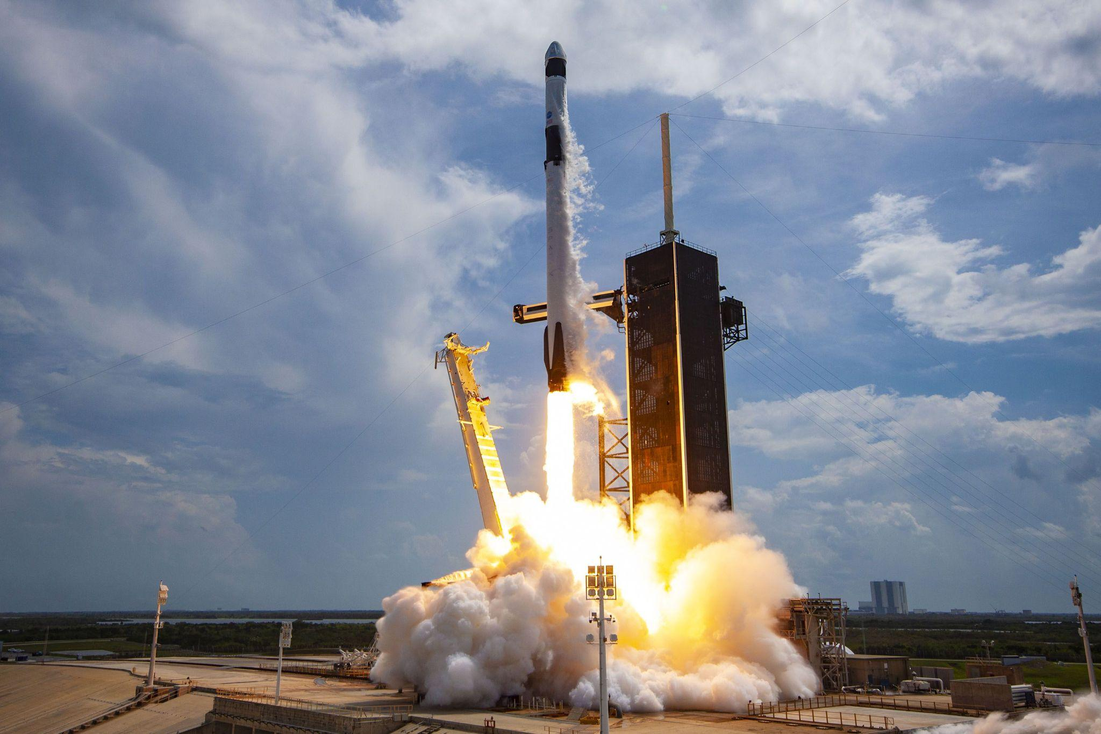
Introduction
Project background and context
SpaceX lists the price for Falcon 9 rocket launches on its website as 62 million dollars, while other providers charge over 165 million dollars for similar services. A significant portion of SpaceX's cost savings comes from its ability to reuse the first stage of the rocket. Thus, by predicting whether the first stage will land successfully, we can estimate the launch cost. This data would be valuable for any competitor aiming to offer a competitive bid against SpaceX for a rocket launch.
Problems you want to find answers
In this capstone project, we'll forecast the success of the Falcon 9's first stage landing using data sourced from Falcon 9 rocket launch details available on its website.

Slide 5

Section 1

Slide 6
Methodology
Executive Summary
Data collection methodology:
Describe how data was collected
Perform data wrangling
Describe how data was processed
Perform exploratory data analysis (EDA) using visualization and SQL
Perform interactive visual analytics using Folium and Plotly Dash
Perform predictive analysis using classification models
How to build, tune, evaluate classification models

Slide 7
Data Collection
Initially, data was gathered from the SpaceX API (a RESTful service) using a 'get' request. To facilitate this, a set of helper functions were created to assist in extracting information based on identification numbers within the launch data. This data was then pulled from the SpaceX API endpoint.
To ensure consistency in the JSON results, we fetched the SpaceX launch data using a GET request. After receiving the response, we decoded the content into a JsonResult and subsequently transformed it into a Pandas dataframe.
Additionally, we scraped Falcon 9 historical launch records from a Wikipedia page titled "List of Falcon 9 and Falcon Heavy launches". These records, present in an HTML format, were extracted using the BeautifulSoup and requests libraries. The HTML table details were then parsed and converted into another Pandas dataframe.

Slide 8
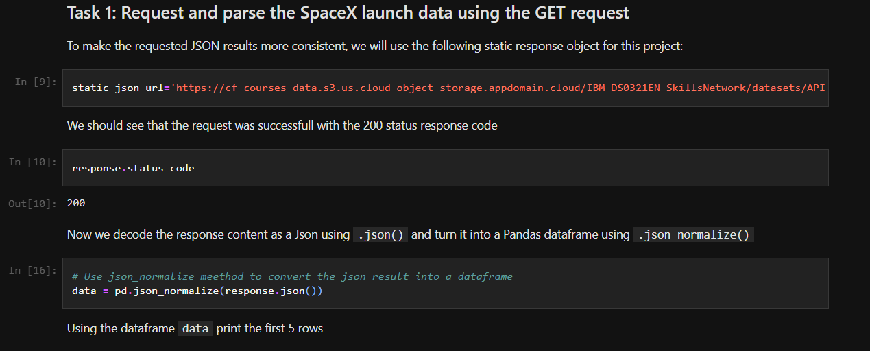
Data Collection – SpaceX API
Data was gathered from the SpaceX API (a RESTful service) using a 'get' request. After fetching the SpaceX launch information through this request, the response content was decoded from JSON and subsequently transformed into a Pandas dataframe.
The Github file URL (https://github.com/YenchiSomnambule/IBM_SpaceX_Prediction/blob/main/1.%20SpaceX%20%20Falcon%209%20first%20stage%20Landing%20Prediction.ipynb)
Place your flowchart of SpaceX API calls here

Slide 9
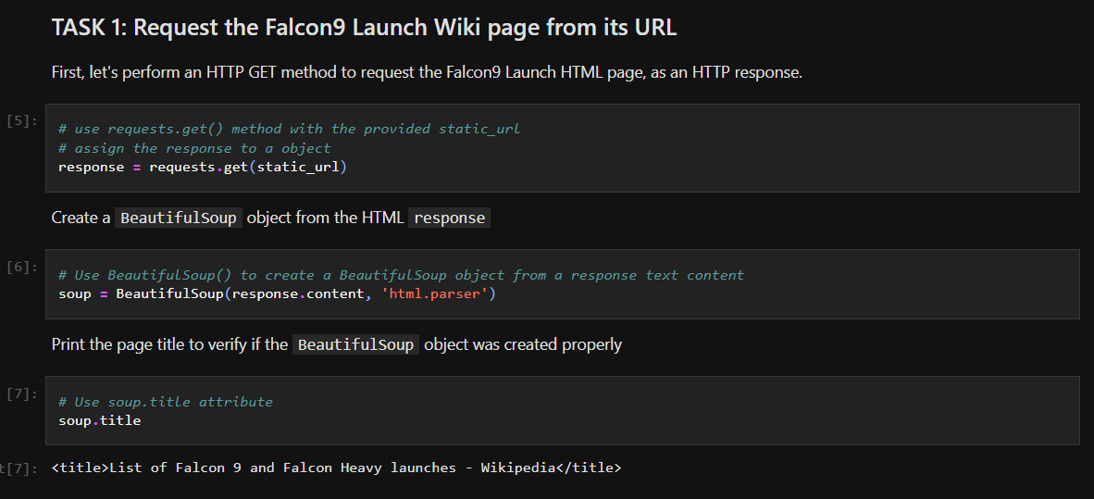
Data Collection - Scraping
I used web scraping techniques to retrieve Falcon 9 historical launch data from a Wikipedia page. Utilizing BeautifulSoup and the requests library, I extracted the Falcon 9 launch details from the Wikipedia page's HTML table. This extracted data was then parsed and converted into a dataframe.
Github URL: https://github.com/YenchiSomnambule/IBM_SpaceX_Prediction/blob/main/2.%20Web%20scraping%20Falcon%209%20and%20Falcon%20Heavy%20Launches%20Records%20from%20Wikipedia.ipynb
Place your flowchart of web scraping here

Slide 10
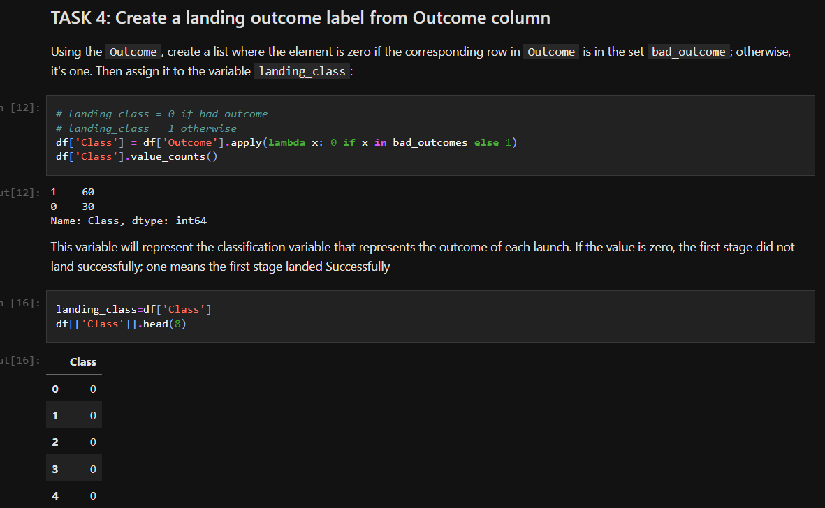
Data Wrangling
After transforming the gathered data into a Pandas dataframe, I filtered it using the 'BoosterVersion' column to retain only the Falcon 9 launches. I then addressed the missing values in the 'LandingPad' and 'PayloadMass' columns. For 'PayloadMass', I substituted missing entries with the column's average value.
I also conducted exploratory data analysis (EDA) to identify patterns in the data and establish the label for training the supervised models.
Github URL: https://github.com/YenchiSomnambule/IBM_SpaceX_Prediction/blob/main/3.%20Data%20wrangling.ipynb

Slide 11
EDA with Data Visualization
I carried out data analysis and feature engineering utilizing Pandas and Matplotlib, which included:
Conducting exploratory data analysis (EDA)
Engaging in data preparation and feature engineering
Utilizing scatter plots to examine the relationships between Flight Number & Launch Site, Payload & Launch Site, Flight Number & Orbit Type, and Payload & Orbit Type.
Employing bar charts to assess the success rate for each orbit type
Using line plots to track the annual trend of launch successes
Github URL: https://github.com/YenchiSomnambule/IBM_SpaceX_Prediction/blob/main/5.%20Space-X%20EDA%20DataViz%20Using%20Pandas%20and%20Matplotlib%20-%20SpaceX.ipynb

Slide 12
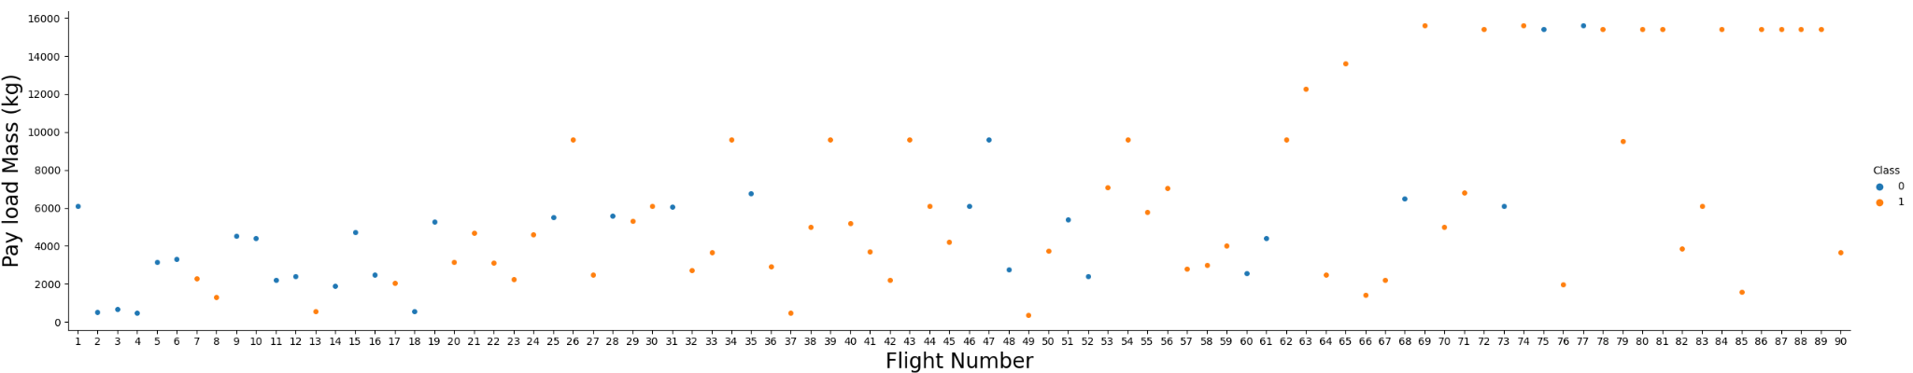
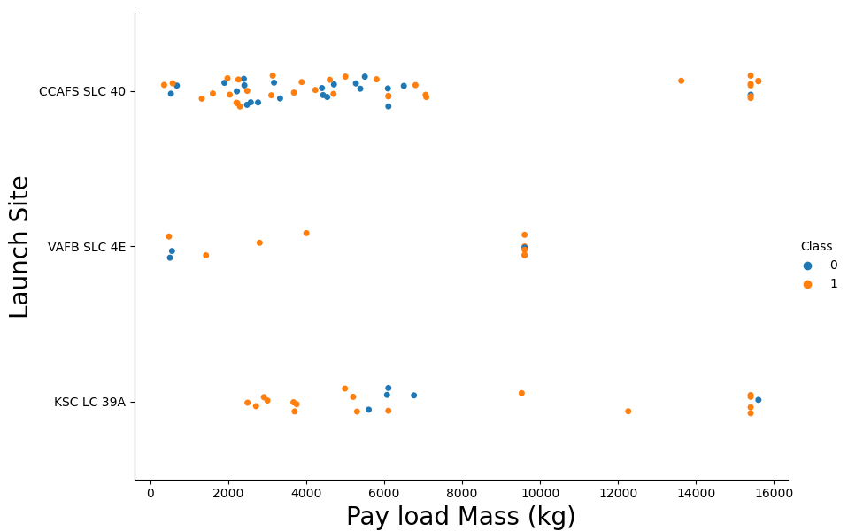
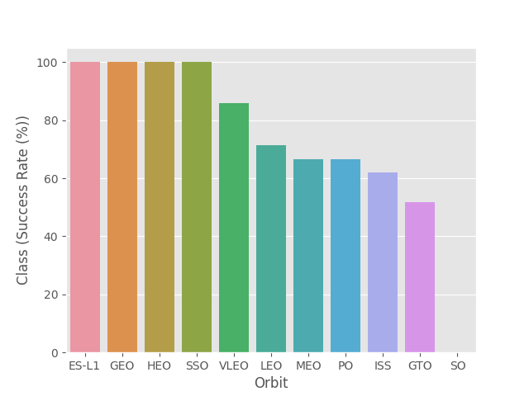
EDA with Data Visualization

Slide 13
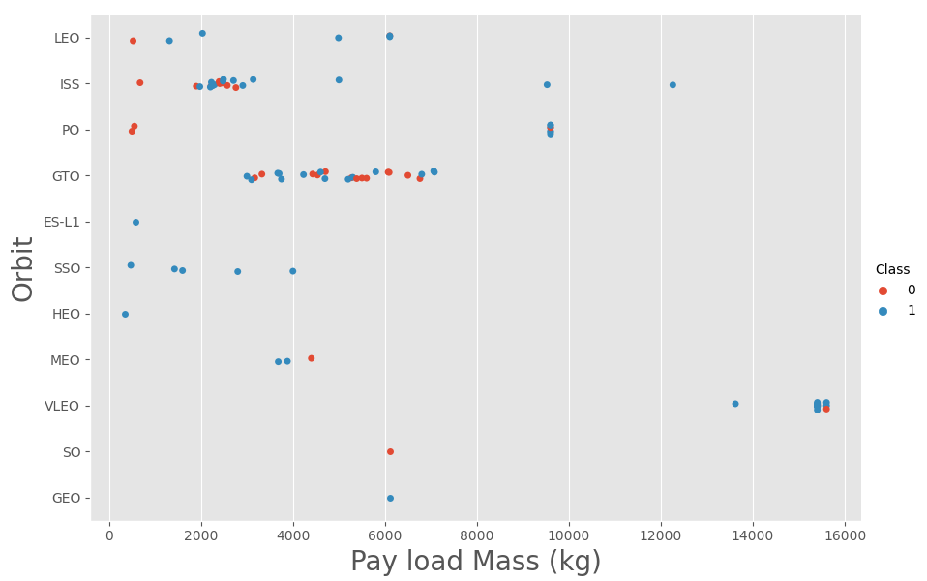
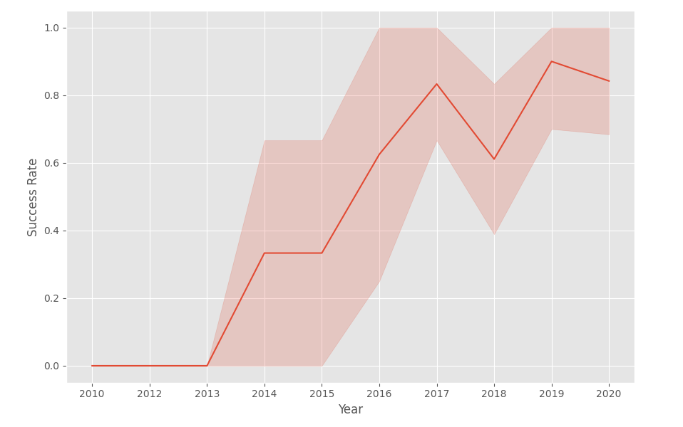
EDA with Data Visualization

Slide 14
EDA with SQL
The following SQL are used for EDA
Display the names of the unique launch sites in the space mission %sql SELECT DISTINCT LAUNCH_SITE as "Launch_Sites" FROM SPACEXTBL;
Display 5 records where launch sites begin with the string 'CCA' %sql SELECT * FROM 'SPACEXTBL' WHERE Launch_Site LIKE 'CCA%' LIMIT 5;
Display the total payload mass carried by boosters launched by NASA (CRS) %sql SELECT SUM(PAYLOAD_MASS__KG_) as "Total Payload Mass(Kgs)", Customer FROM 'SPACEXTBL' WHERE Customer = 'NASA (CRS)';
Display average payload mass carried by booster version F9 v1.1 %sql SELECT AVG(PAYLOAD_MASS__KG_) as "Payload Mass Kgs", Customer, Booster_Version FROM 'SPACEXTBL' WHERE Booster_Version LIKE 'F9 v1.1%';
List the date when the first succesful landing outcome in ground pad was acheived. %sql SELECT MIN(DATE) FROM 'SPACEXTBL' WHERE "Landing _Outcome" = "Success (ground pad)";

Slide 15
EDA with SQL
The following SQL are used for EDA
List the names of the boosters which have success in drone ship and have payload mass greater than 4000 but less than 6000 %sql SELECT DISTINCT Booster_Version, Payload FROM SPACEXTBL WHERE "Landing _Outcome" = "Success (drone ship)" AND PAYLOAD_MASS__KG_ > 4000 AND PAYLOAD_MASS__KG_ < 6000;
List the total number of successful and failure mission outcomes %sql SELECT "Mission_Outcome", COUNT("Mission_Outcome") as Total FROM SPACEXTBL GROUP BY "Mission_Outcome";
List the names of the booster_versions which have carried the maximum payload mass. Use a subquery %sql SELECT "Booster_Version",Payload, "PAYLOAD_MASS__KG_" FROM SPACEXTBL WHERE "PAYLOAD_MASS__KG_" = (SELECT MAX("PAYLOAD_MASS__KG_") FROM SPACEXTBL);

Slide 16
EDA with SQL
The following SQL are used for EDA
List the records which will display the month names, failure landing_outcomes in drone ship ,booster versions, launch_site for the months in year 2015. %sql SELECT substr(Date,7,4), substr(Date, 4, 2),"Booster_Version", "Launch_Site", Payload, "PAYLOAD_MASS__KG_", "Mission_Outcome", "Landing _Outcome" FROM SPACEXTBL WHERE substr(Date,7,4)='2015' AND "Landing _Outcome" = 'Failure (drone ship)';
Rank the count of successful landing_outcomes between the date 04-06-2010 and 20-03-2017 in descending order. %sql SELECT * FROM SPACEXTBL WHERE "Landing _Outcome" LIKE 'Success%' AND (Date BETWEEN '04-06-2010' AND '20-03-2017') ORDER BY Date DESC;
Github URL: https://github.com/YenchiSomnambule/IBM_SpaceX_Prediction/blob/main/4e.%20Space-X%20EDA%20Using%20SQL.ipynb

Slide 17
Build an Interactive Map with Folium
I developed a folium map to pinpoint all the launch sites and incorporated map elements like markers, circles, and lines to denote the success or failure of launches at each site.
I also established a set of launch outcomes, categorizing them as failure (0) or success (1).
Github URL: https://github.com/YenchiSomnambule/IBM_SpaceX_Prediction/blob/main/6.Space-X%20Launch%20Sites%20Locations%20Analysis%20with%20Folium-Interactive%20Visual%20Analytics.ipynb

Slide 18
Build a Dashboard with Plotly Dash
I constructed an interactive dashboard using Plotly Dash, which involved:
Incorporating a dropdown input component for selecting a Launch Site
Integrating a callback function to display a success pie chart corresponding to the chosen site from the dropdown
Embedding a Range Slider for payload selection
Instituting a callback function to showcase the success-payload-scatter-chart as a scatter plot.
Github URL:
https://github.com/YenchiSomnambule/IBM_SpaceX_Prediction/blob/main/7.%20Build%20an%20Interactive%20Dashboard%20with%20Ploty%20Dash%20-%20spacex_dash_app.py

Slide 19
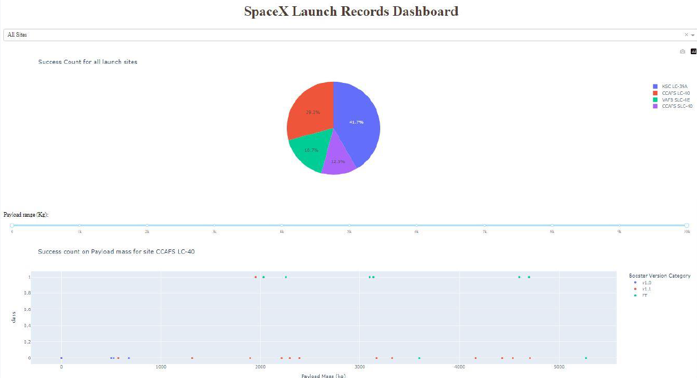
Build a Dashboard with Plotly Dash

Slide 20
Predictive Analysis (Classification)
Here's a brief overview of how I developed, assessed, refined, and identified the optimal classification model
Upon loading the data into a Pandas Dataframe, I embarked on exploratory data analysis and defined the training labels. This involved:
Converting the 'Class' column from the data into a NumPy array using the to_numpy() method and designating it to the 'Y' variable as our target.
I then standardized the feature dataset (x) utilizing the preprocessing.StandardScaler() method from Sklearn.
Subsequently, I partitioned the data into training and testing subsets using train_test_split from sklearn.model_selection, setting test_size to 0.2 and random_state to 2.

Slide 21
Predictive Analysis (Classification)
To determine the most effective ML model/method for the test data among SVM, Classification Trees, k-nearest neighbors, and Logistic Regression:
I began by initializing an object for each algorithm and then set up a GridSearchCV object, providing a set of parameters for each model.
For every model being assessed, I instantiated the GridSearchCV object with cv=10, then integrated the training data into each GridSearch object to identify the optimal hyperparameters.
Post training, I retrieved the best parameters for each model using the best_params_ attribute and ascertained the validation data accuracy with the best_score_ attribute.
Concluding the process, I employed the score method to gauge the test data accuracy for each model. Additionally, I visualized the results by plotting a confusion matrix using the actual and predicted outcomes for each model.
Eventually, the test accuracy of Logistic Regression, SVM, Decision tree and KNN are calculated with all of them are 0.833
Github URL: https://github.com/YenchiSomnambule/IBM_SpaceX_Prediction/blob/main/8.%20SpaceX%20Machine%20Learning%20Prediction.ipynb

Slide 22
Results
Exploratory data analysis results
Interactive analytics demo in screenshots
Predictive analysis results

Slide 23

Section 2

Slide 24
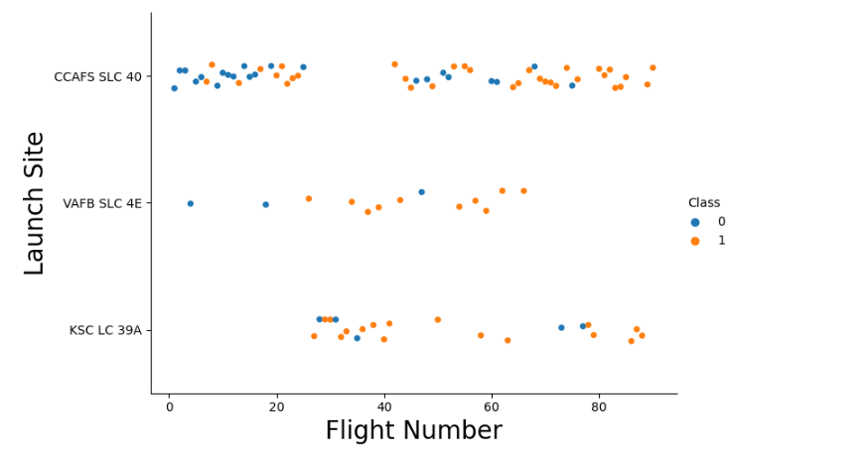
Flight Number vs. Launch Site
Show a scatter plot of Flight Number vs. Launch Site
Show the screenshot of the scatter plot with explanations

Slide 25
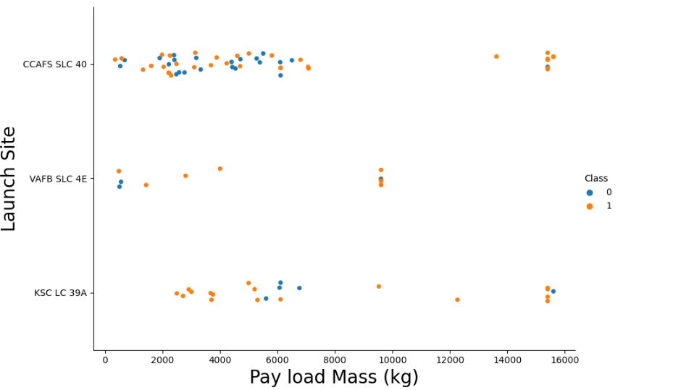
Payload vs. Launch Site
Show a scatter plot of Payload vs. Launch Site
Show the screenshot of the scatter plot with explanations

Slide 26
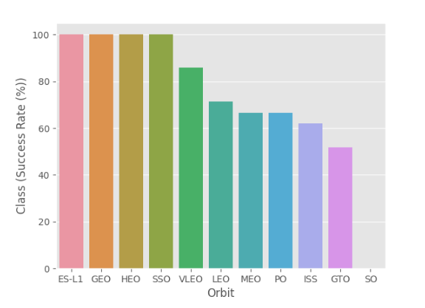
Success Rate vs. Orbit Type
Show a bar chart for the success rate of each orbit type
Show the screenshot of the scatter plot with explanations

Slide 27
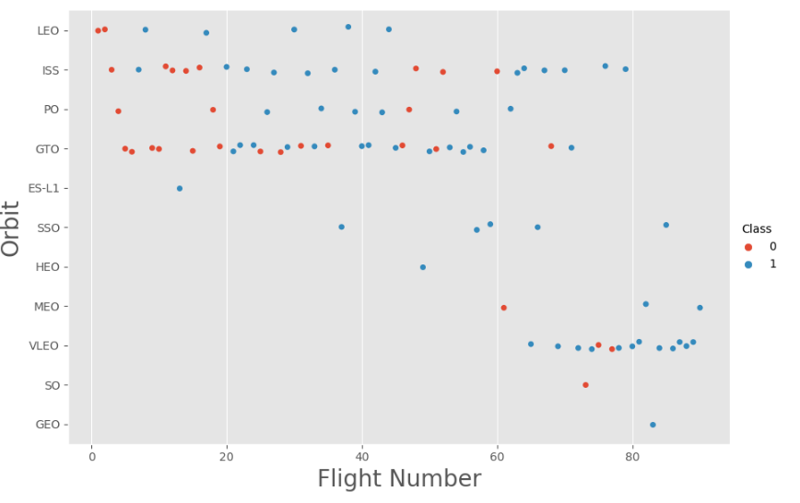
Flight Number vs. Orbit Type
Show a scatter point of Flight number vs. Orbit type
Show the screenshot of the scatter plot with explanations

Slide 28
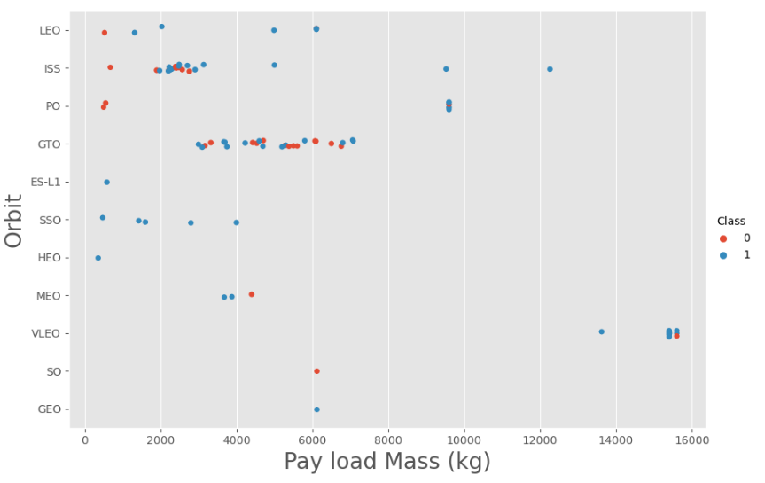
Payload vs. Orbit Type
Show a scatter point of payload vs. orbit type
Show the screenshot of the scatter plot with explanations

Slide 29
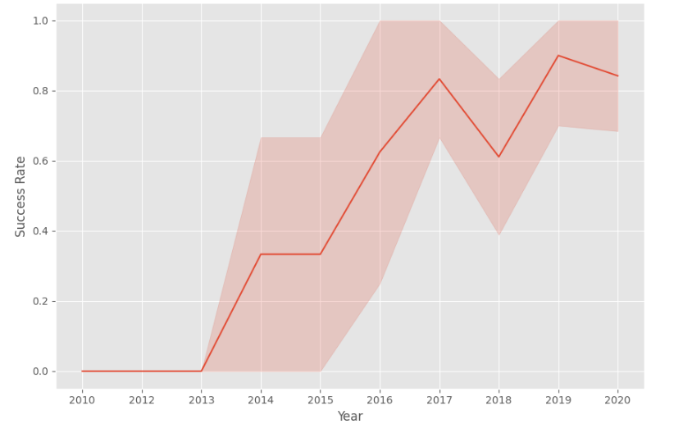
Launch Success Yearly Trend
Show a line chart of yearly average success rate
Show the screenshot of the scatter plot with explanations

Slide 30
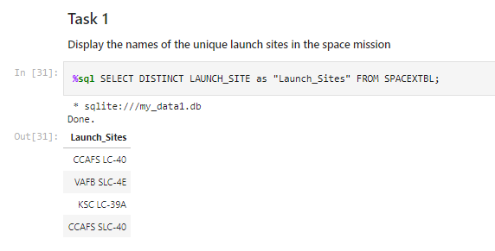
All Launch Site Names
Find the names of the unique launch sites
Present your query result with a short explanation here

Slide 31
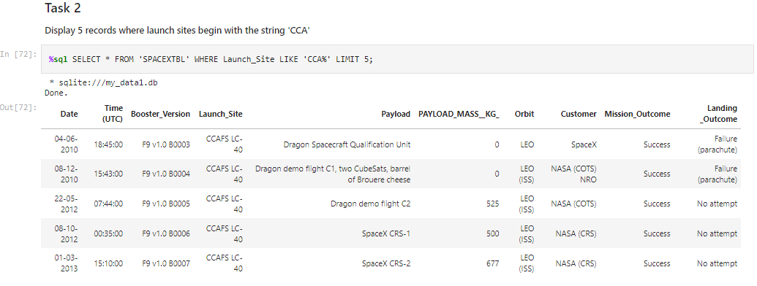
Launch Site Names Begin with 'CCA'
Find 5 records where launch sites begin with `CCA`
Present your query result with a short explanation here

Slide 32
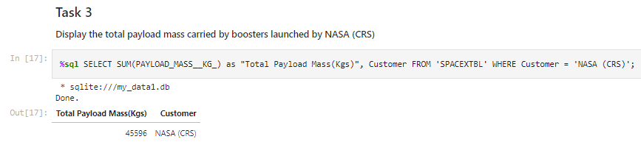
Total Payload Mass
Calculate the total payload carried by boosters from NASA
Present your query result with a short explanation here

Slide 33
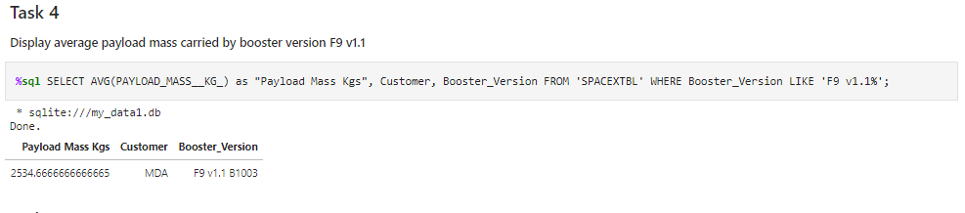
Average Payload Mass by F9 v1.1
Calculate the average payload mass carried by booster version F9 v1.1
Present your query result with a short explanation here

Slide 34
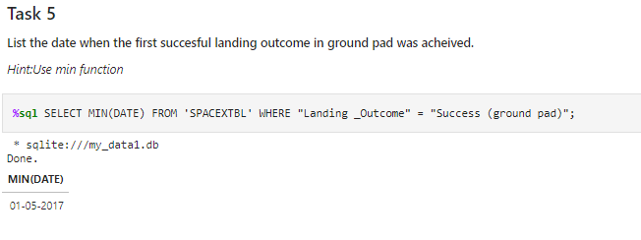
First Successful Ground Landing Date
Find the dates of the first successful landing outcome on ground pad
Present your query result with a short explanation here

Slide 35
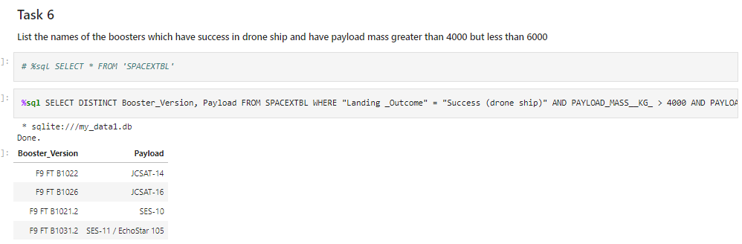
Successful Drone Ship Landing with Payload between 4000 and 6000
List the names of boosters which have successfully landed on drone ship and had payload mass greater than 4000 but less than 6000
Present your query result with a short explanation here

Slide 36
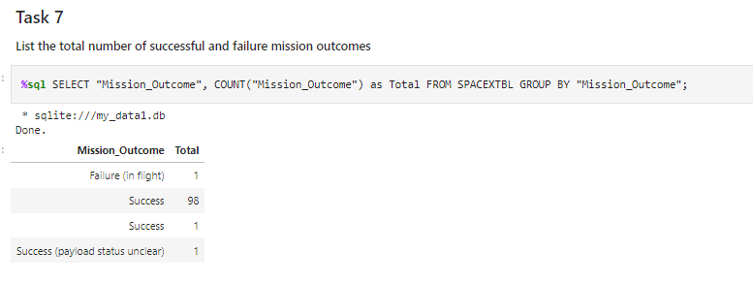
Total Number of Successful and Failure Mission Outcomes
Calculate the total number of successful and failure mission outcomes
Present your query result with a short explanation here

Slide 37
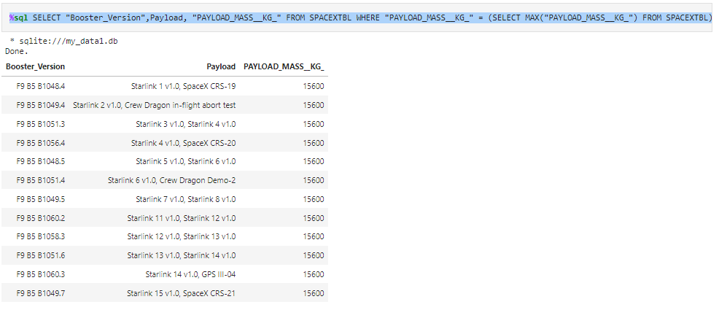
Boosters Carried Maximum Payload
List the names of the booster which have carried the maximum payload mass
Present your query result with a short explanation here

Slide 38
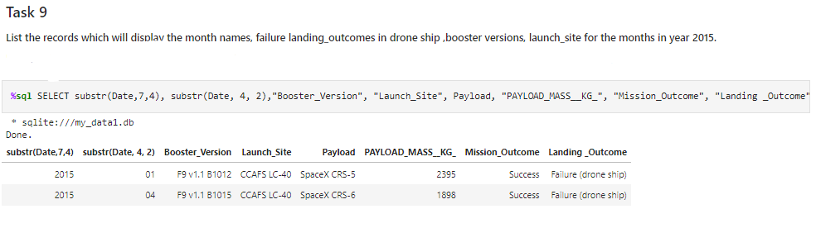
2015 Launch Records
List the failed landing_outcomes in drone ship, their booster versions, and launch site names for in year 2015
Present your query result with a short explanation here

Slide 39
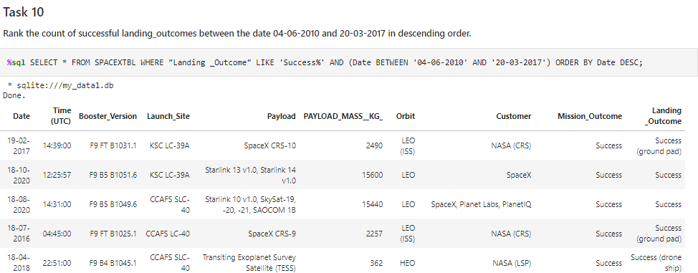
Rank Landing Outcomes Between 2010-06-04 and 2017-03-20
Rank the count of landing outcomes (such as Failure (drone ship) or Success (ground pad)) between the date 2010-06-04 and 2017-03-20, in descending order
Present your query result with a short explanation here

Slide 40

Section 3

Slide 41
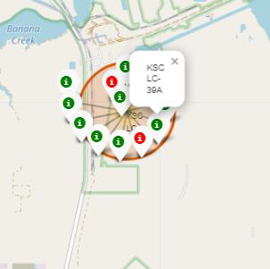
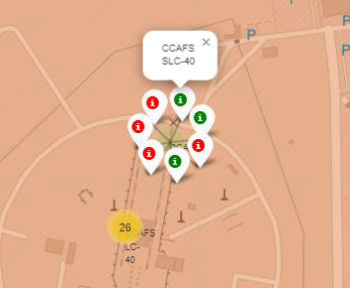
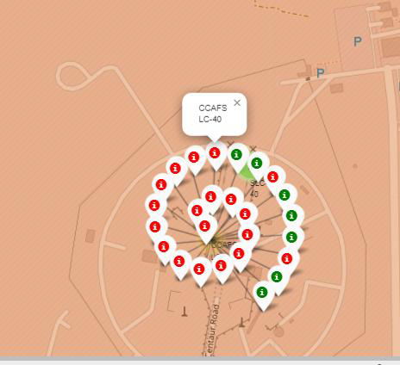
<Launch Sites Clusters plots>

Slide 42
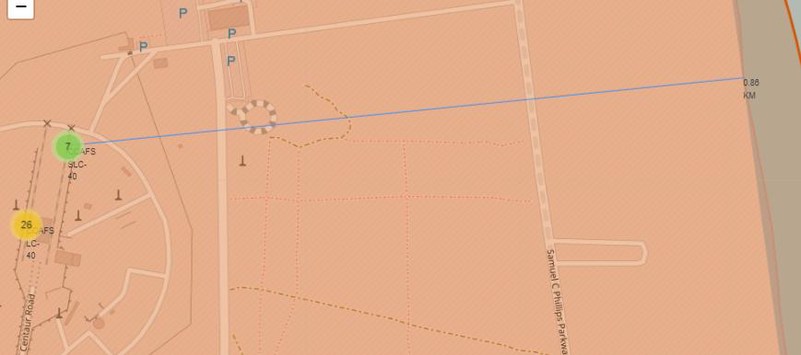
<Launch Sites Distance plot>
Replace <Folium map screenshot 2> title with an appropriate title
Explore the folium map and make a proper screenshot to show the color-labeled launch outcomes on the map
Explain the important elements and findings on the screenshot

Slide 43
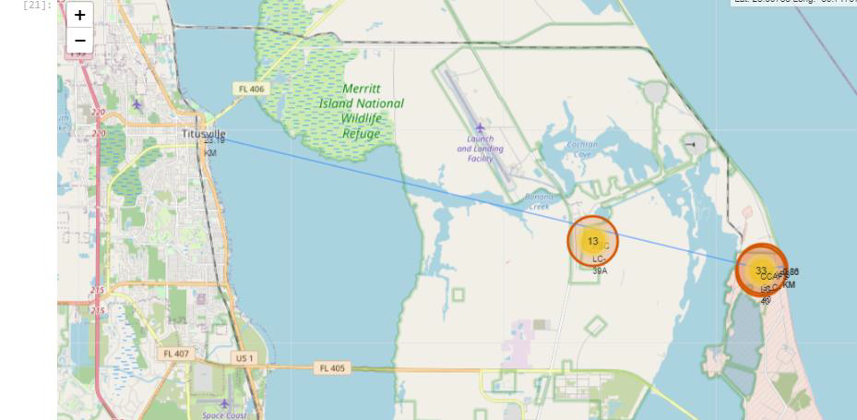
<Launch Sites distance plot>
Replace <Folium map screenshot 1> title with an appropriate title
Explore the generated folium map and make a proper screenshot to include all launch sites’ location markers on a global map
Explain the important elements and findings on the screenshot

Slide 44

Section 4

Slide 45
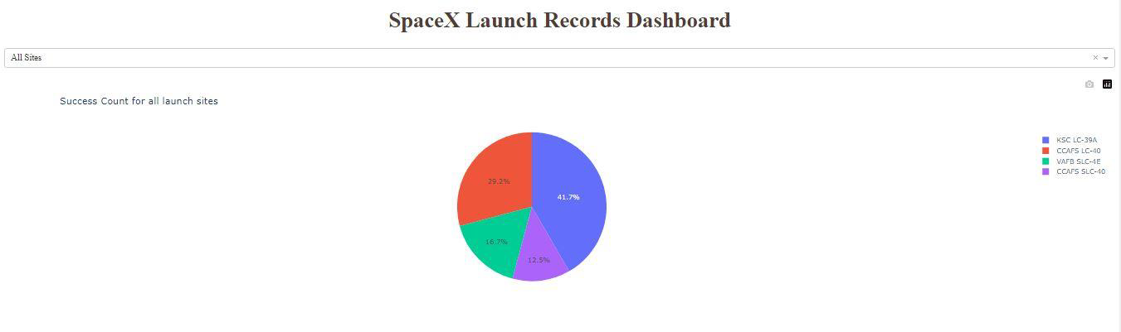
Success Count for all launch sites (Pie chart)

Slide 46
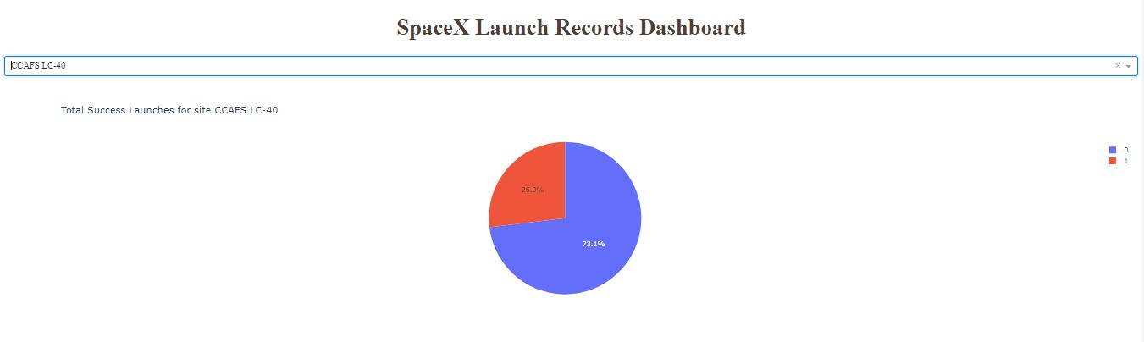
Total Success Launches for site CCAFS LC-40 (Pie Chart)
Replace <Dashboard screenshot 2> title with an appropriate title
Show the screenshot of the piechart for the launch site with highest launch success ratio
Explain the important elements and findings on the screenshot

Slide 47
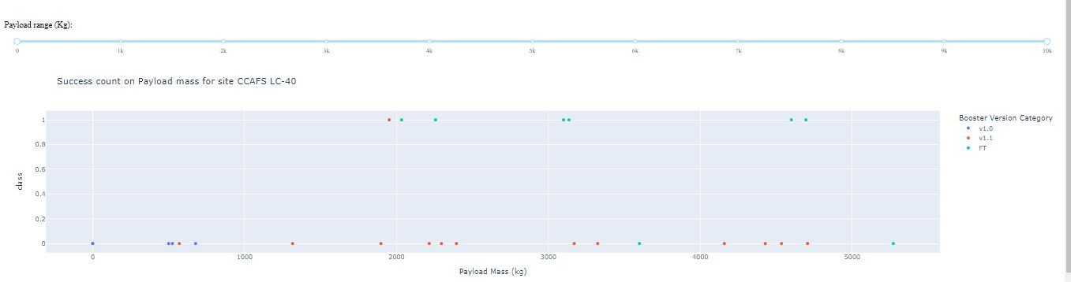
Success count on payload mass for site CCAFS LC-40 (scatter plot)
Replace <Dashboard screenshot 3> title with an appropriate title
Show screenshots of Payload vs. Launch Outcome scatter plot for all sites, with different payload selected in the range slider
Explain the important elements and findings on the screenshot, such as which payload range or booster version have the largest success rate, etc.

Slide 48

Section 5

Slide 49
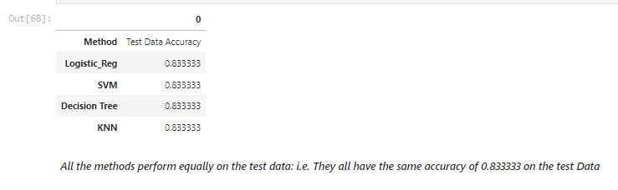
Classification Accuracy
Visualize the built model accuracy for all built classification models, in a bar chart
Find which model has the highest classification accuracy

Slide 50
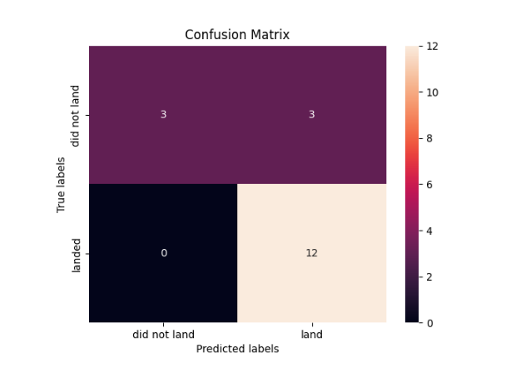
Confusion Matrix
Show the confusion matrix of t

Slide 51
Conclusions
A trend emerges when observing each of the three launch sites: as the flight number rises, so does the success rate. For instance, post the 50th flight, VAFB SLC 4E maintains a 100% success rate. Both KSC LC 39A and CCAFS SLC 40 reach a 100% success benchmark after their 80th flight.
Examining the Payload vs. Launch Site scatter chart, it's evident that the VAFB-SLC launch site hasn't embarked on launches for heavy payloads (exceeding 10,000).
Orbits ES-L1, GEO, HEO, and SSO consistently demonstrate top-tier success rates of 100%. In contrast, the SO orbit trails behind, only achieving roughly a 50% success rate, with certain instances of a 0% success rate.
For the LEO orbit, success seems to correlate with the number of flights. Yet, this correlation doesn't hold true for the GTO orbit.
For substantial payloads, successful landings or high landing success rates are predominantly observed for Polar, LEO, and ISS orbits. However, in the case of GTO, the distinction isn't as clear, with both successful and unsuccessful landings being present.
Moreover, from 2013 onwards, there's been a consistent uptrend in the success rate, peaking in 2020.

Slide 52


